Slide 1
FIRE DETECTION USING OPENCV AND G-STREAMER
Project-II submitted in partial fulfilment of the requirements for the degree of
Bachelor of technology
by
SUBHA CHAKRABORTY (12020002011014)
SUBROTO RAKSHIT (12020002016039)
PRATYUSH RANJAN (12020002004036)
PRABHAT KUMAR (12020002016037)
PAYEL CHATTERJEE (1202000204054)
AJAY KUMAR MANDAL(12020002016040)
Under the guidance of
Prof . Ayan Kumar Panja Sir
(Assistant H.O.D)
Institute of Engineering & Management
29-11-2023

Slide 2
Presentation Outline
APPLICATION DOMAIN OF THE PROJECT
MOTIVATIONS BEHIND PURSUING THE PROJECT AND CONTRIBUTIONS OF OUR TEAM MEMBERS
PROPOSED APPROACH TO ADDRESS OUR PROBLEM STATEMENT
EXPERIMENTAL RESULTS OF OUR PROJECT
CONCLUSION

Slide 3
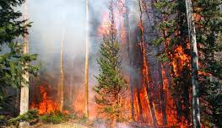
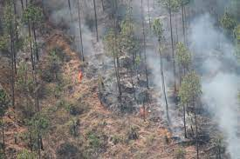
Application Domain
The project deals with detecting Forest fire and smoke in real-time, from video input received via local video(CCTV) devices, and can be used to inform authorities to take appropriate action.
Ff
FF
FOREST FIRE DETECTION
SMOKE DETECTION IN FOREST

Slide 4
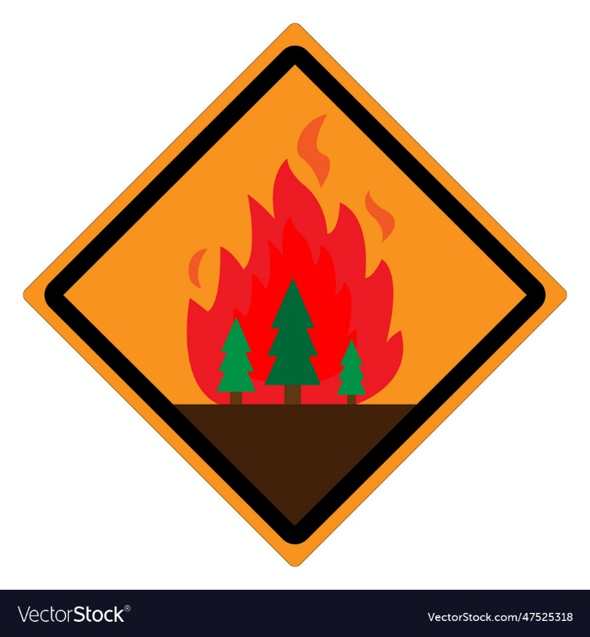
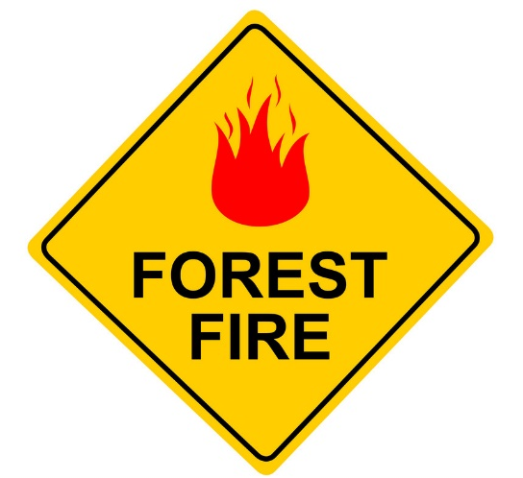
Motivation
Forest Fires have deadly immediate as well as everlasting consequences, as not only it causes the loss of animal life and their habitats, large-scale burning of trees can disrupt the climatic conditions(aiding in global warming), and leading to unprecedented ecological disaster.
Deadly Forest Fires in India:
2016 Uttarakhand Forest fires.
2019 Bandipur Forest fires.
2020 Uttarakhand Forest fires.
2020-21 Dzüko Valley Forest fire.
2021 Simlipal Forest fires.
If we could detect fire automatically and in real-time, we can possible aid authorities in taking action sooner, thereby avoiding an ecological disaster.
This is what motivated us to pursue this project.

Slide 5

Contribution
NAME | CONCEPTUALIZATION | INVESTIGATION | WRITING ORIGINAL DRAFT- REPORT | CODING AND SIMULATION | VISUALIZATION
SUBHA CHAKRABORTY
PRATYUSH RANJAN
SUBROTO RAKSHIT
PRABHAT KUMAR
PAYEL CHATTERJEE
AJAY KUMAR MANDAL

Slide 6
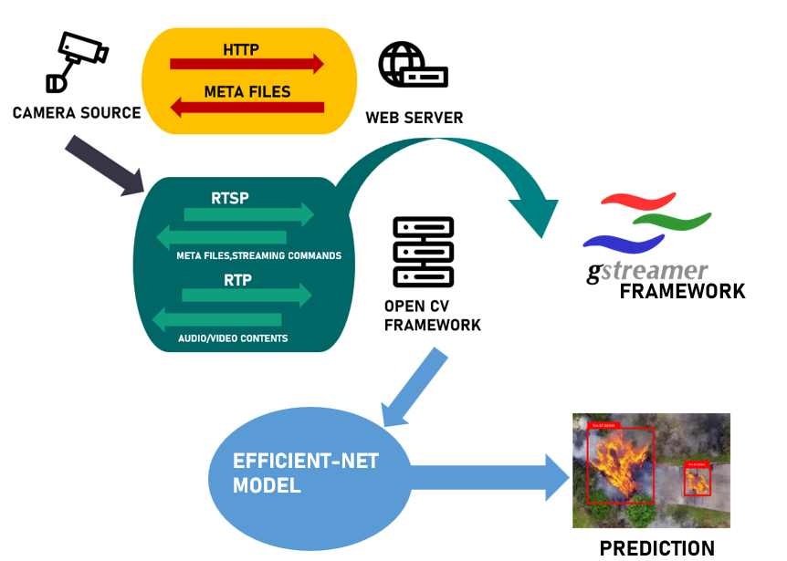
Proposed approach
FROM CAMERA SOURCE, VIDEO INFORMATION SEND TO LOCAL HOST, USING RTSP PROTOCOL(GSTREAMER FRAMEWORK).
IN THE LOCAL HOST, OPEN CV FRAMEWORK TAKES THE VIDEO INPUT AND SENDS FRAMES TO EFFICIENT-NET MODEL.
EFFICIENT-NET MODEL MAKES THE PREDICTION ON THE INFORMATION, TO PREDICT FIRE.

Slide 7
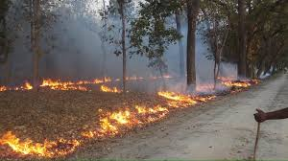
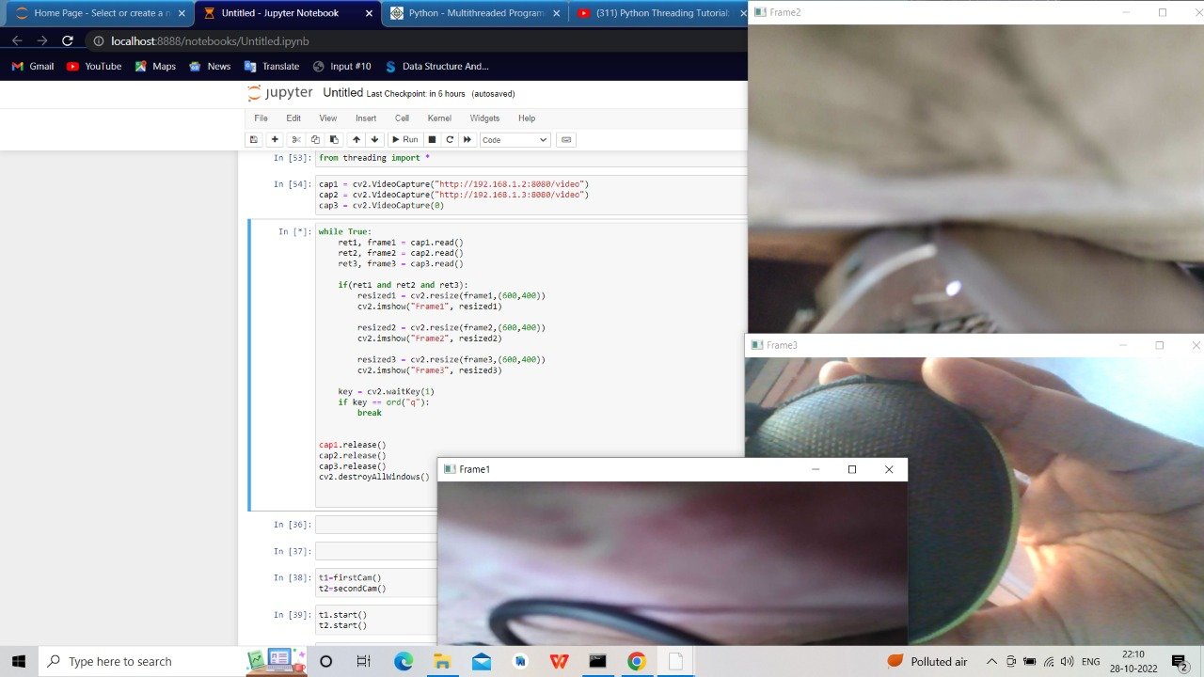
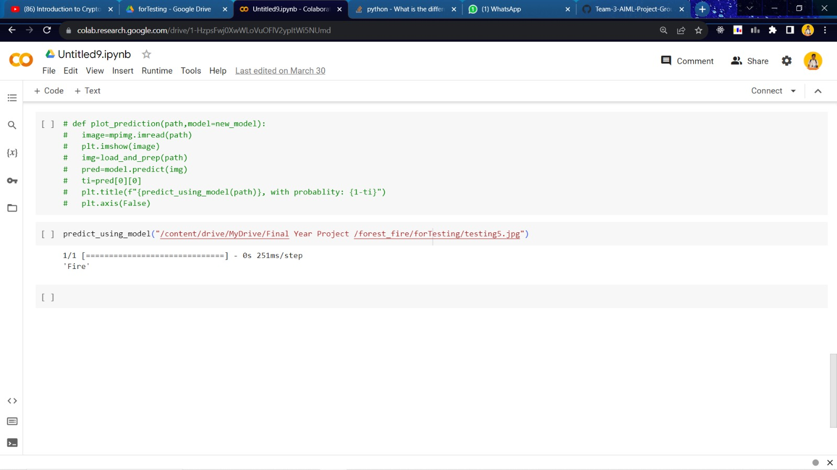
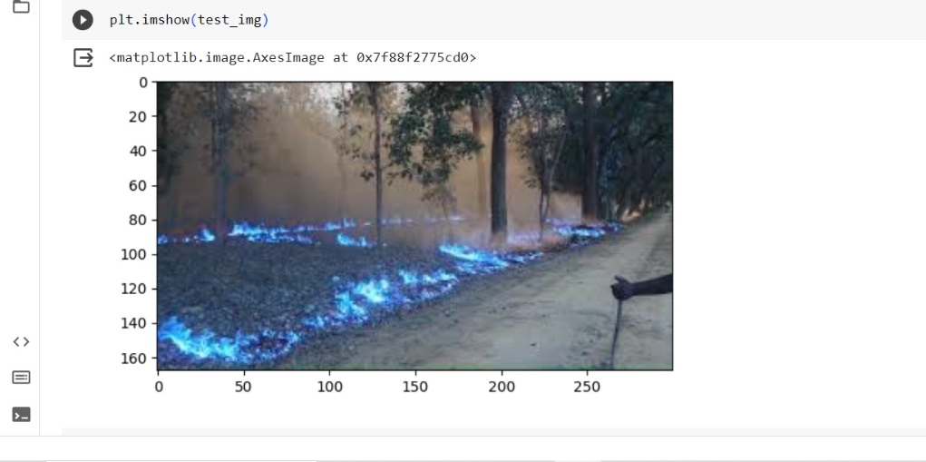
Proposed approach(Cont..)
FROM CAMERA SOURCE, VIDEO INFORMATION SEND TO LOCAL HOST, USING RTSP PROTOCOL(GSTREAMER FRAMEWORK).
FOREST FIRE IDENTIFIED
IN THE LOCAL HOST, OPEN CV FRAMEWORK TAKES THE VIDEO INPUT AND SENDS FRAMES TO EFFICIENT-NET MODEL.
EFFICIENT-NET MODEL MAKES THE PREDICTION ON THE INFORMATION, TO PREDICT
MULTI-CAMERA ACCESS IN REAL TIMEFIRE.
IDENTIFIED AREA UNDER FIRE GIVEN BLUE COLOURATION

Slide 8
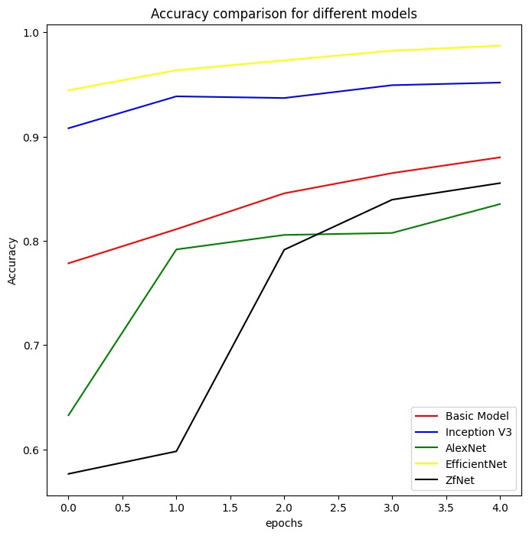
Experimental Results
PARAMETER | VALUES
LEARNING RATE | 1.40E-04
BATCH SIZE | 32
EPOCHS | 5
OPTIMIZER | ADAM OPTIMIZER
LOSS FUNCTION | BINARY CROSS ENTROY
KERNEL SIZE | 3X3
ACTIVATION FUNCTION | SIGMOID
REGULARIZATION METHOD | DROPOUT
REGULARIZATION RATE | 0.5

Slide 9
Conclusion
In Conclusion,
The project deals with real time detection of forest fire and smoke.
The video information from local CCTVs and other camera sources is taken, on which predictions is made using a CNN model, to detect forest fire.
Efficient-Net is chosen as the predicting model, after trying multiple models, it has the highest precision(98.71), accuracy(99.1) and F1 Score(99.12).
This system can be integrated with pre-existing warning systems(ex:- SMS warning, etc), and will aid authorities to know about forest fire faster, thereby ensuring the fire is dealt with as soon as possible.

Slide 10
Research Paper Publication Status: Ongoing
Link to Project Report : https://github.com/P-4-PRATYUSH-RANJAN/Team-3-AIML-Project-Group/blob/main/Final_Year_Project_Paper%20(6).pdf

Slide 11
References
Robert A. Sowah, Abdul R. Ofoli, Selase N. Krakani, Seth Yayra Fiawoo https://ieeexplore.ieee.org/abstract/document/7575685
Yi-Chun Chen, Halim Fathoni, ChaoTung Yang
https://ieeexplore.ieee.org/abstract/document/9302759
Sergio Saponara, Abdussalam Elhanashi, Alessio Gagliardi
https: //link.springer.com/article/10.1007/s11554- 020-01044-0
---------------------------------------------------------X----------X-----------------------------------------------------

